Slide 1
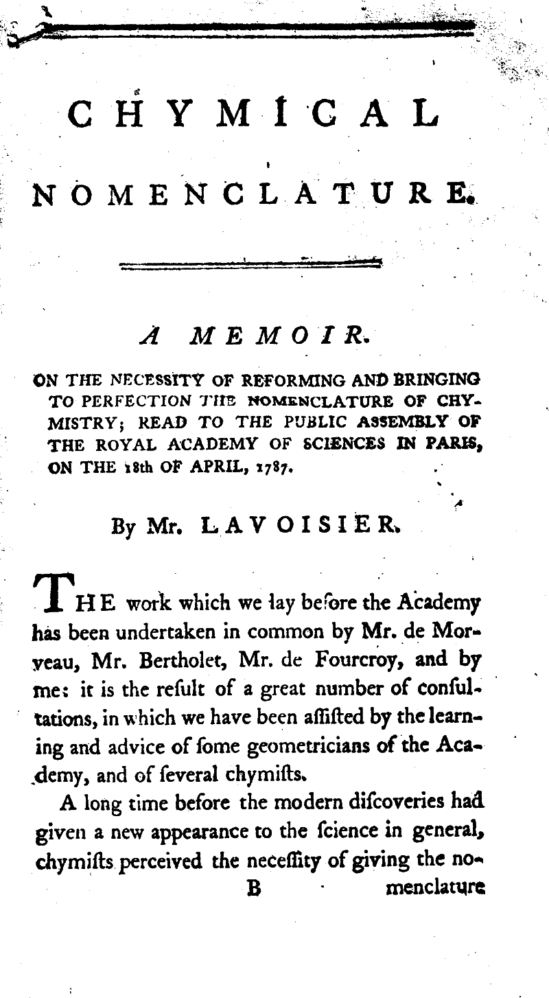
Nomenclature
Lesson Nine

Slide 2
Ionic Nomenclature
Let’s review some of the features of ionic compounds
Metals give up electrons to form positively charged cations
Non-metals gain electrons to form negatively charged anions
Ionic compounds are formed from the interaction between cations and anions

Slide 3
Ionic Nomenclature
When we name an ionic compound, we write the name of the cation comes first followed by the name of the anion, changing the name of the anion to end in –ide for monotomic anions. The names of polyatomic anions are not altered.

Slide 4
Examples
NaCl → sodium chloride
ZnI₂ → zinc iodide
NaNO₃ → sodium nitrate
Ag₂CO₃ → silver carbonate
(NH₄)₂SO₄ → ammonium sulfate

Slide 5
Molecular Nomenclature
Binary Molecular Compounds
When a pair of elements form more than one type of covalent compound, Greek prefixes are used to indicate how many of each element are in a compound. The more electronegative element is written last and its ending is changed to –ide.
Least electronegative atom goes first

Slide 6
Greek Numbers
mono → 1
di → 2
tri → 3
tetra → 4
penta → 5
hexa → 6
hepta → 7
octa → 8

Slide 7
Examples
N₂O → dinitrogen monoxide
NO → nitrogen monoxide
N₂O₃ → dinitrogen trioxide
N₂O₅ → dinitrogen pentoxide

