Slide 1
VSEPR QUIZ
Can you determine the molecular shapes of these molecules?

Slide 2
What is the molecular structure of methane? (CH₄)
A – Bent
B – Tetrahedral
C – Trigonal Planar
D – Trigonal Bipyramidal

Slide 3
Sorry
That was the wrong answer

Slide 4
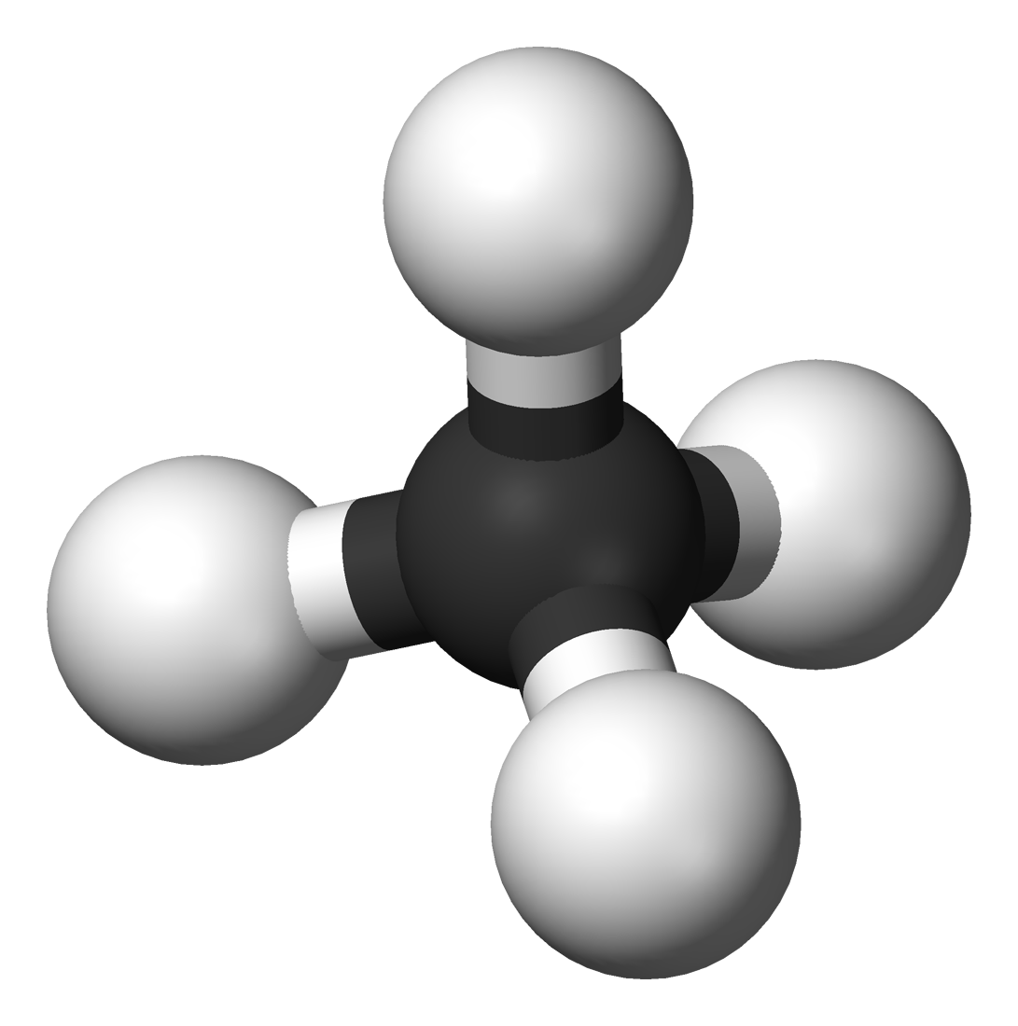
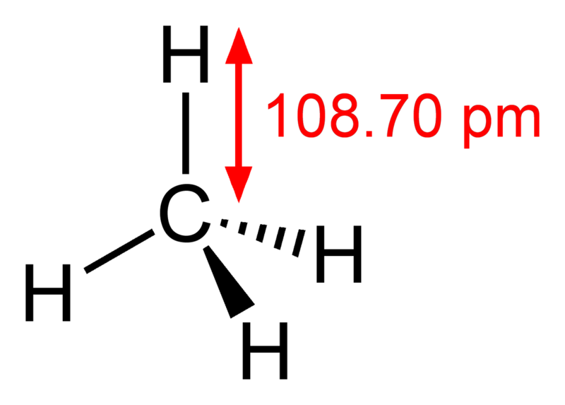
Correct !
Congratulations

Slide 5
What is the molecular Geometry about the central atom of Ammonia? (NH₃)
A – Bent
B – Trigonal Pyramidal
C – Trigonal Planar
D – Tetrahedral

Slide 6
Sorry
That was the wrong answer

Slide 7
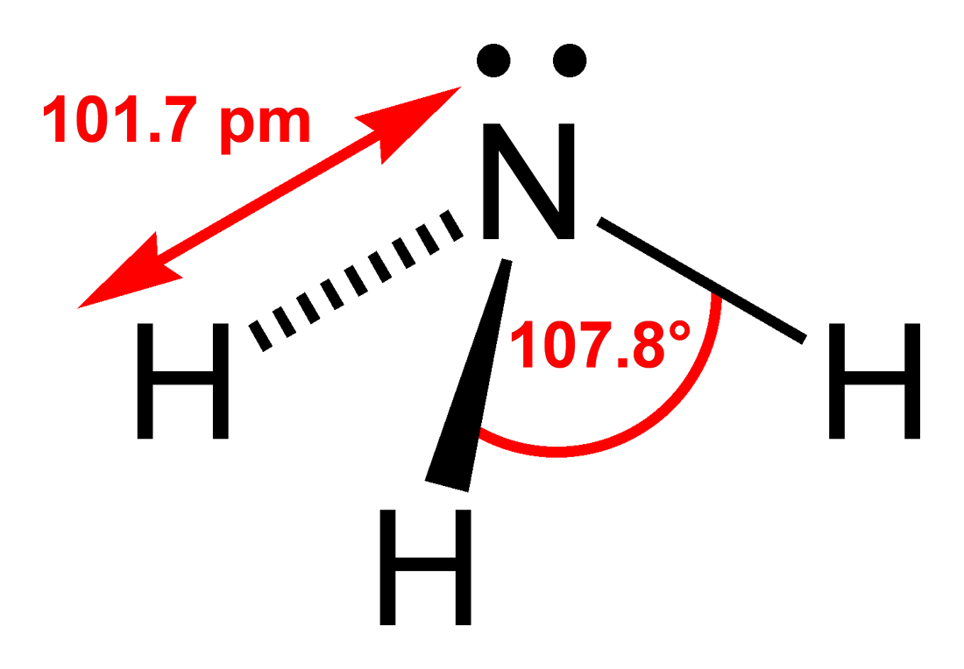
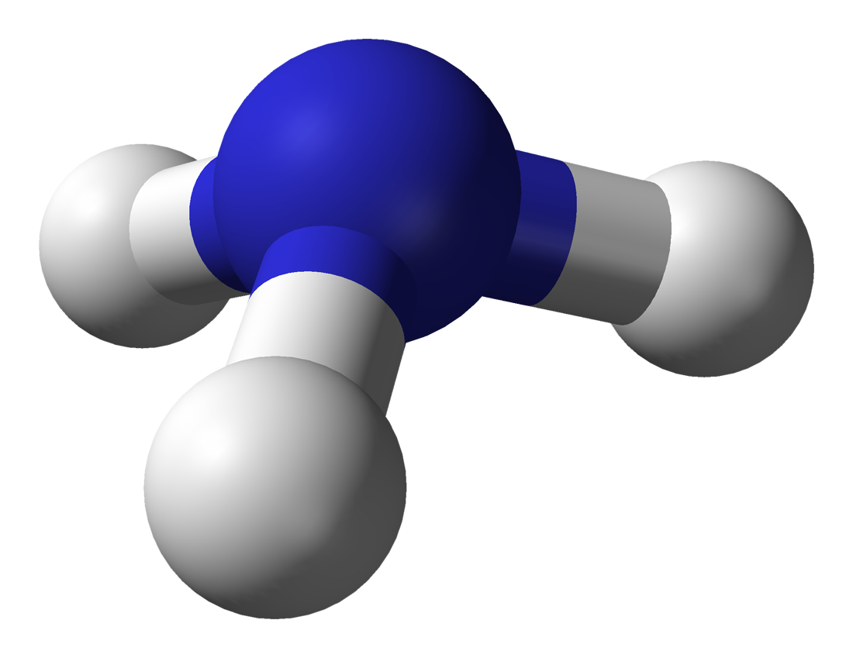
Correct !
Congratulations

Slide 8
What is the molecular geometry about the central molecule in Carbon dioxide?
A – Bent
B – Linear
C – Tetrahedral
D – Trigonal Bipyramidal

Slide 9
Sorry
That was the wrong answer

Slide 10
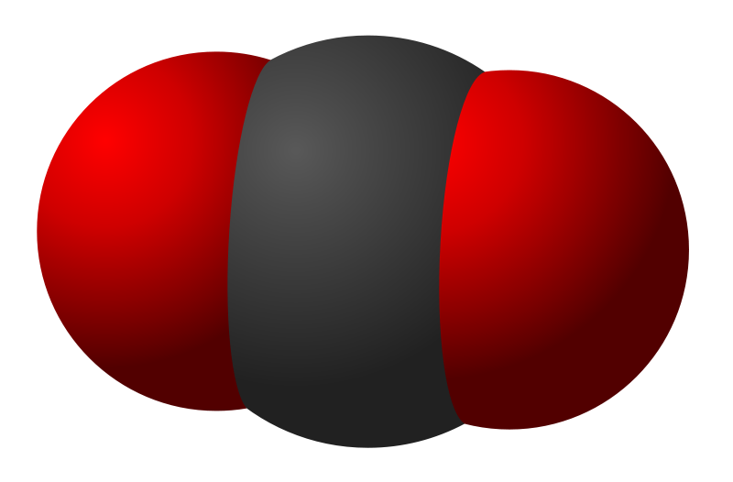
Correct !
Congratulations

Slide 11
Cyanate ion: (OCN)
A – Bent
B – Linear
C – Tetrahedral
D – Trigonal Pyramidal

Slide 12
Sorry
That was the wrong answer

Slide 13
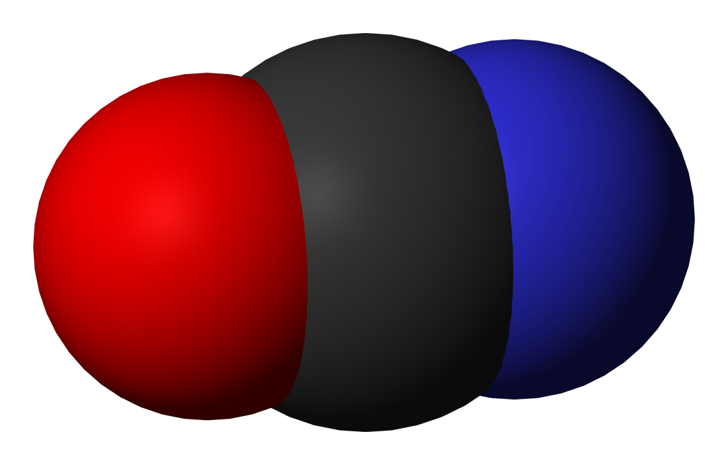
Correct !
Congratulations

Slide 14
Oxygen Difluoride
A - Bent
B – Linear
C – Tetrahedral
D – Trigonal Bipyramidal

Slide 15
Sorry
That was the wrong answer

Slide 16
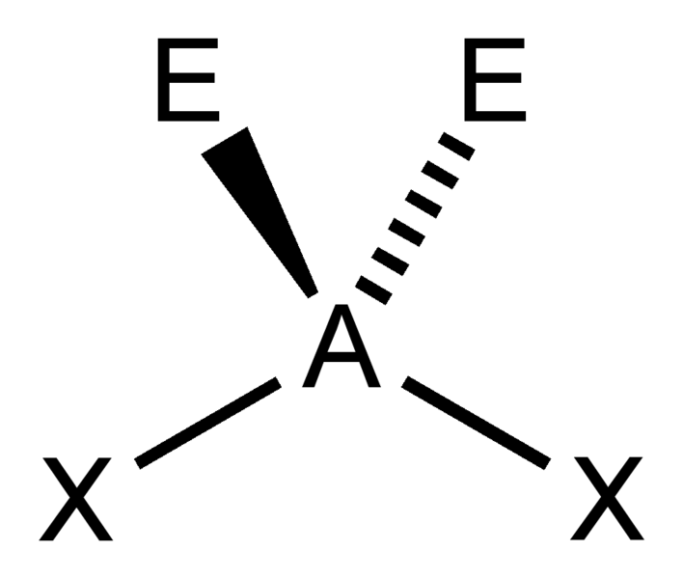
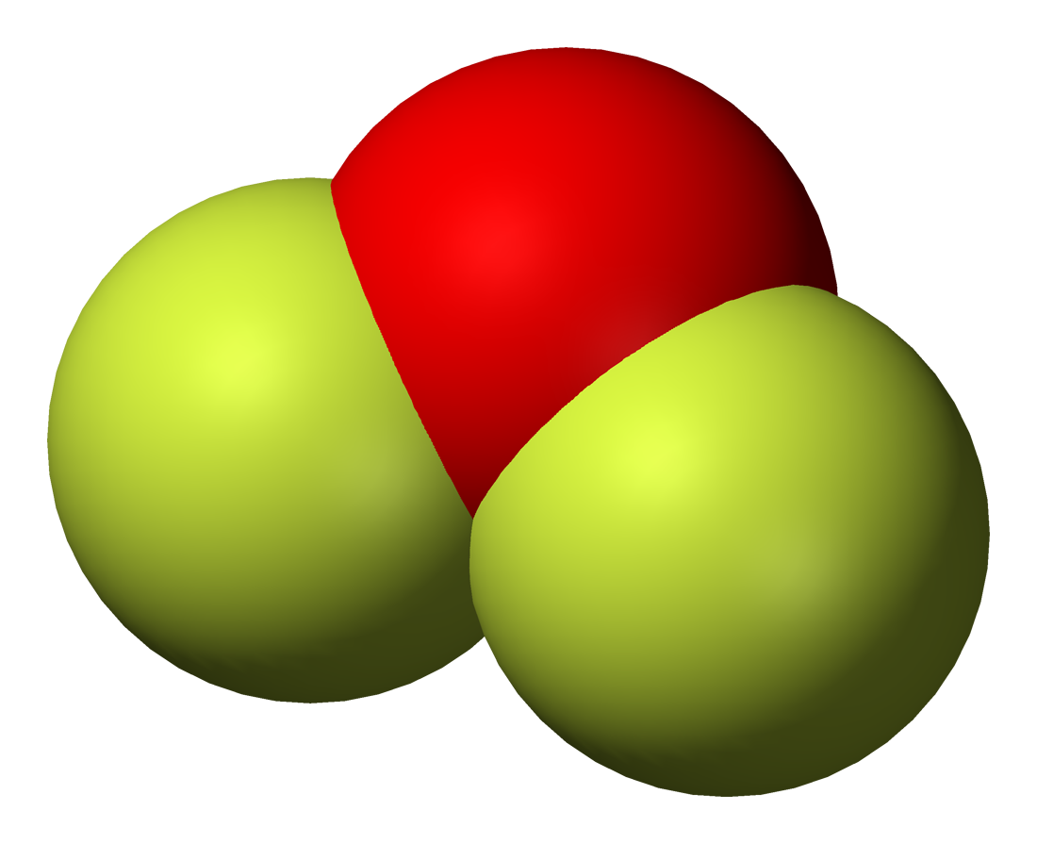
Correct !
Congratulations

Slide 17
BORANE
A - Bent
B - Trigonal Planar
C - Linear
D - Trigonal Bipyramidal

Slide 18
Sorry
That was the wrong answer

Slide 19
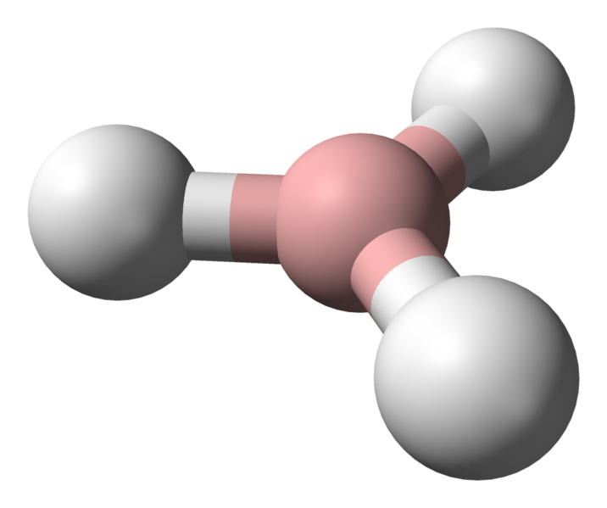
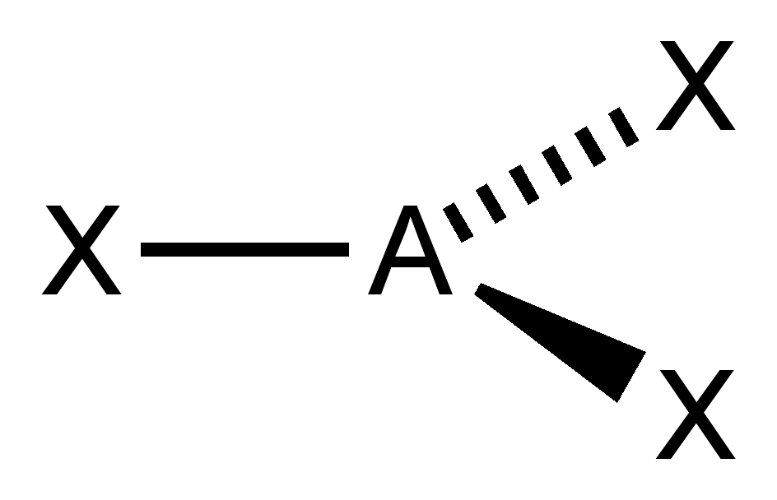
Correct !
Congratulations

Slide 20
Silicon TRIchloride
A- Bent
B – Linear
C – Trigonal Bipyramidal
D – Trigonal Pyramidal

Slide 21
Sorry
That was the wrong answer

Slide 22
Correct !
Congratulations

